Slide 1
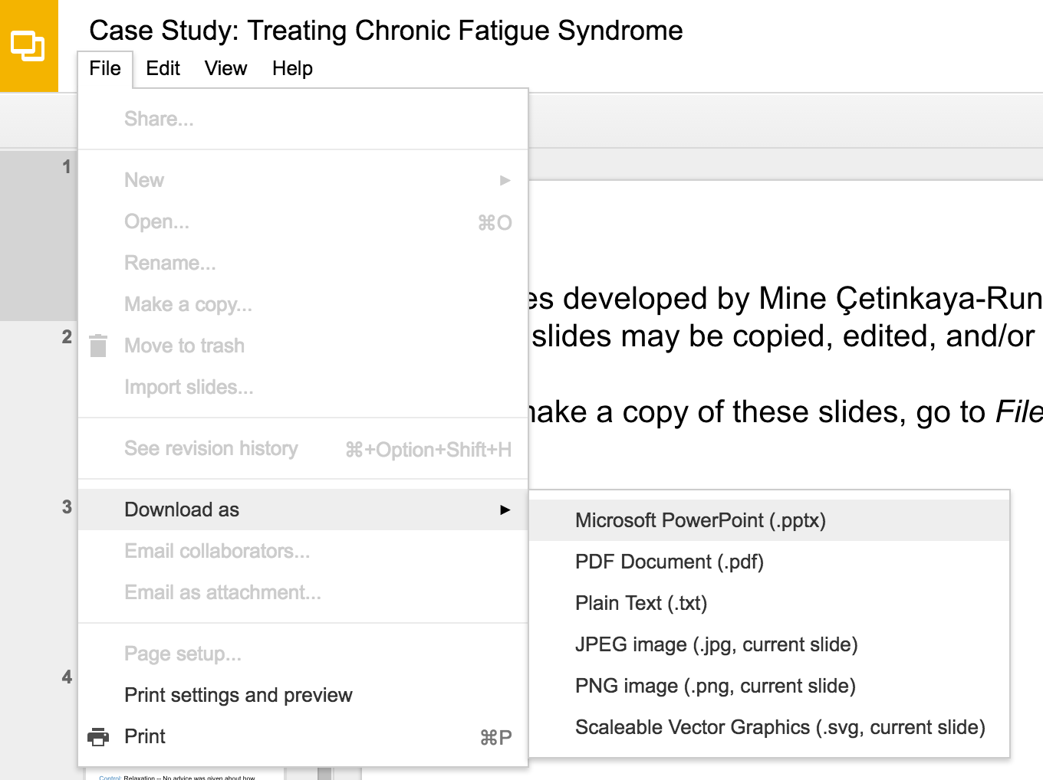
Slides developed by Mine Çetinkaya-Rundel of OpenIntro
Translated from LaTeX to Google Slides by Curry W. Hilton of OpenIntro.
The slides may be copied, edited, and/or shared via the CC BY-SA license
To make a copy of these slides, go to File > Download as > [option], as shown below. Or if you are logged into a Google account, you can choose Make a copy... to create your own version in Google Drive.

Slide 2
Fitting a line by least squares regression

Slide 3
A measure for the best line
We want a line that has small residuals

Slide 4
A measure for the best line
We want a line that has small residuals
Option 1: Minimize the sum of magnitudes (absolute values) of residuals |e₁| + |e₂| + … + |e_{n}|

Slide 5
A measure for the best line
We want a line that has small residuals
Option 1: Minimize the sum of magnitudes (absolute values) of residuals |e₁| + |e₂| + … + |e_{n}|
Option 2: Minimize the sum of squared residuals -- least squares
e₁² + e₂² + … + e_{n}²

Slide 6
A measure for the best line
We want a line that has small residuals
Option 1: Minimize the sum of magnitudes (absolute values) of residuals |e₁| + |e₂| + … + |e_{n}|
Option 2: Minimize the sum of squared residuals -- least squares
e₁² + e₂² + … + e_{n}²
Why least squares?

Slide 7
A measure for the best line
We want a line that has small residuals
Option 1: Minimize the sum of magnitudes (absolute values) of residuals |e₁| + |e₂| + … + |e_{n}|
Option 2: Minimize the sum of squared residuals -- least squares
e₁² + e₂² + … + e_{n}²
Why least squares?
Most commonly used

Slide 8
A measure for the best line
We want a line that has small residuals
Option 1: Minimize the sum of magnitudes (absolute values) of residuals |e₁| + |e₂| + … + |e_{n}|
Option 2: Minimize the sum of squared residuals -- least squares
e₁² + e₂² + … + e_{n}²
Why least squares?
Most commonly used
Easier to compute by hand and using software

Slide 9
A measure for the best line
We want a line that has small residuals
Option 1: Minimize the sum of magnitudes (absolute values) of residuals |e₁| + |e₂| + … + |e_{n}|
Option 2: Minimize the sum of squared residuals -- least squares
e₁² + e₂² + … + e_{n}²
Why least squares?
Most commonly used
Easier to compute by hand and using software
In many applications, a residual twice as large as another is usually more than twice as bad

Slide 10
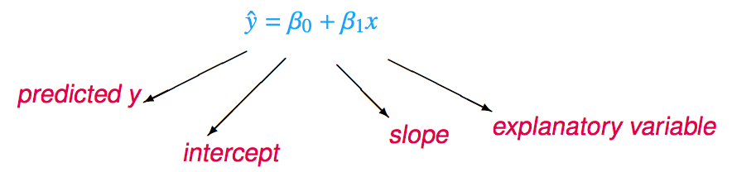
The least squares line
Notation:
Intercept:
Parameter: β₀
Point estimate: b₀
Slope:
Parameter: β₁
Point estimate: b₁

Slide 11
Conditions for the least squares line
Linearity

Slide 12
Conditions for the least squares line
Linearity
Nearly normal residuals

Slide 13
Conditions for the least squares line
Linearity
Nearly normal residuals
Constant variability

Slide 14
Conditions: (1) Linearity
The relationship between the explanatory and the response variable should be linear.

Slide 15
Conditions: (1) Linearity
The relationship between the explanatory and the response variable should be linear.
Methods for fitting a model to non-linear relationships exist, but are beyond the scope of this class. If this topic is of interest, an Online Extra is available on openintro.org covering new techniques.

Slide 16
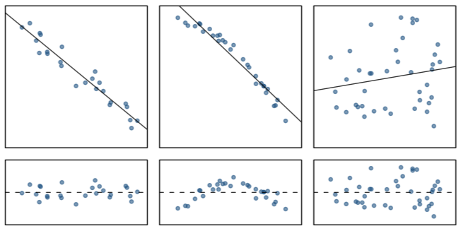
Conditions: (1) Linearity
The relationship between the explanatory and the response variable should be linear.
Methods for fitting a model to non-linear relationships exist, but are beyond the scope of this class. If this topic is of interest, an Online Extra is available on openintro.org covering new techniques.
Check using a scatterplot of the data, or a residuals plot.

Slide 17
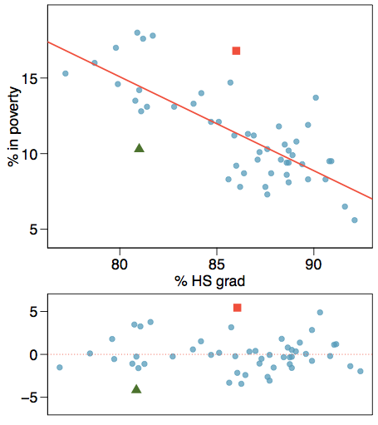
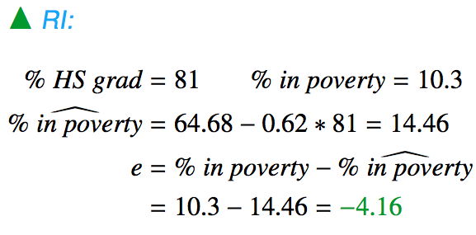
Anatomy of a residuals plot

Slide 18
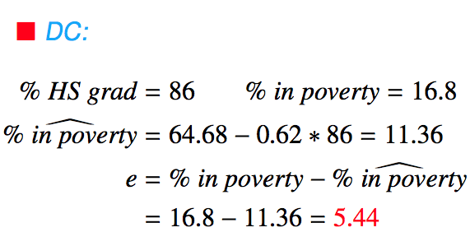
Anatomy of a residuals plot

Slide 19
Conditions: (2) Nearly normal residuals
The residuals should be nearly normal.

Slide 20
Conditions: (2) Nearly normal residuals
The residuals should be nearly normal.
This condition may not be satisfied when there are unusual observations that don't follow the trend of the rest of the data.

Slide 21
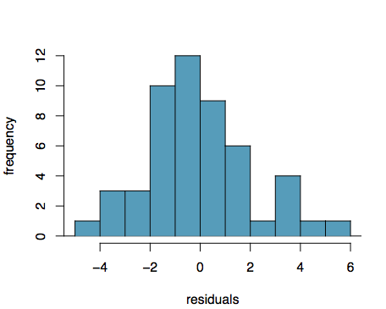
Conditions: (2) Nearly normal residuals
The residuals should be nearly normal.
This condition may not be satisfied when there are unusual observations that don't follow the trend of the rest of the data.
Check using a histogram or normal probability plot of residuals.

Slide 22
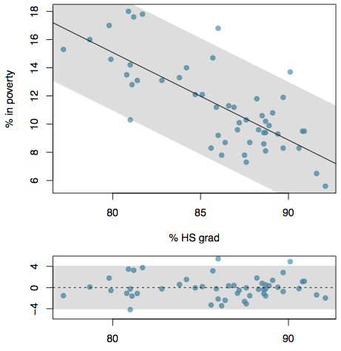
Conditions: (3) Constant variability
The variability of points around the least squares line should be roughly constant.

Slide 23
Conditions: (3) Constant variability
The variability of points around the least squares line should be roughly constant.
This implies that the variability of residuals around the 0 line should be roughly constant as well.

Slide 24
Conditions: (3) Constant variability
The variability of points around the least squares line should be roughly constant.
This implies that the variability of residuals around the 0 line should be roughly constant as well.
Also called homoscedasticity.

Slide 25
Conditions: (3) Constant variability
The variability of points around the least squares line should be roughly constant.
This implies that the variability of residuals around the 0 line should be roughly constant as well.
Also called homoscedasticity.
Check using a histogram or normal probability plot of residuals.

Slide 26
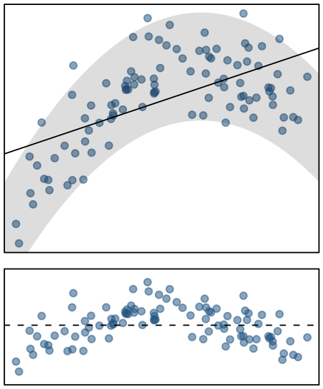
Checking conditions
What condition is this linear model obviously violating?
Constant variability
Linear relationship
Normal residuals
No extreme outliers

Slide 27
Checking conditions
What condition is this linear model obviously violating?
Constant variability
Linear relationship
Normal residuals
No extreme outliers

Slide 28
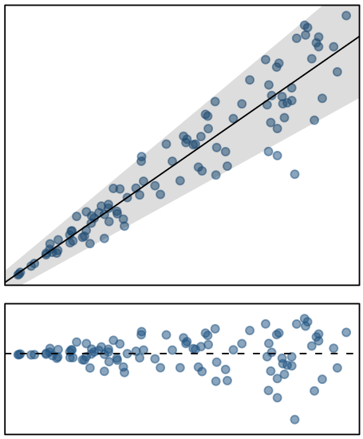
Checking conditions
What condition is this linear model obviously violating?
Constant variability
Linear relationship
Normal residuals
No extreme outliers

Slide 29
Checking conditions
What condition is this linear model obviously violating?
Constant variability
Linear relationship
Normal residuals
No extreme outliers

Slide 30
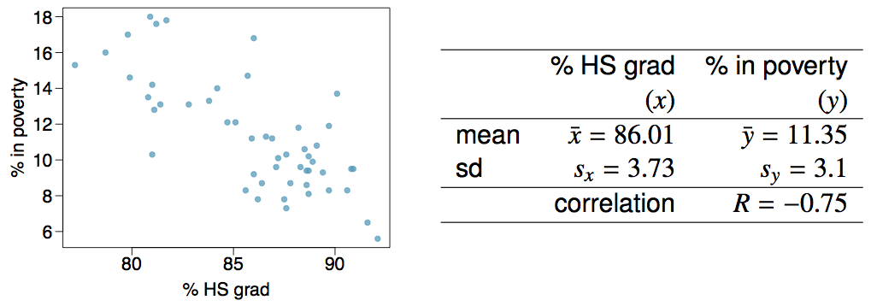
Given...

Slide 31

Slope
The slope of the regression can be calculated as

Slide 32

Slope
The slope of the regression can be calculated as
In context...

Slide 33
Slope
The slope of the regression can be calculated as
In context...
Interpretation
For each additional % point in HS graduate rate, we would expect the % living in poverty to be lower on average by 0.62% points.

Slide 34
Intercept
The intercept is where the regression line intersects the y-axis. The calculation of the intercept uses the fact the a regression line always passes through (x̄, ȳ).
b₀ = ȳ - b₁ x̄

Slide 35
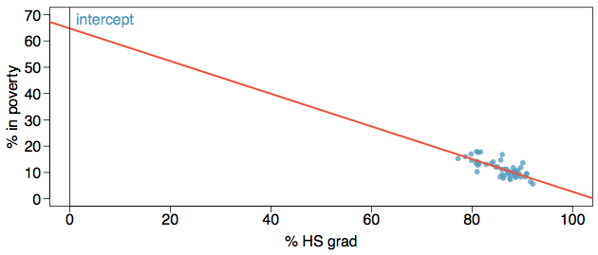
Intercept
The intercept is where the regression line intersects the y-axis. The calculation of the intercept uses the fact the a regression line always passes through (x̄, ȳ).
b₀ = ȳ - b₁ x̄

Slide 36
Intercept
The intercept is where the regression line intersects the y-axis. The calculation of the intercept uses the fact the a regression line always passes through (x̄, ȳ).
b₀ = ȳ - b₁ x̄
b₀ = 11.35 - (-0.62) x 86.01
= 64.68

Slide 37
Which of the following is the correct interpretation of the intercept?
For each % point increase in HS graduate rate, % living in poverty is expected to increase on average by 64.68%.
For each % point decrease in HS graduate rate, % living in poverty is expected to increase on average by 64.68%.
Having no HS graduates leads to 64.68% of residents living below the poverty line.
States with no HS graduates are expected on average to have 64.68% of residents living below the poverty line.
In states with no HS graduates % living in poverty is expected to increase on average by 64.68%.

Slide 38
Which of the following is the correct interpretation of the intercept?
For each % point increase in HS graduate rate, % living in poverty is expected to increase on average by 64.68%.
For each % point decrease in HS graduate rate, % living in poverty is expected to increase on average by 64.68%.
Having no HS graduates leads to 64.68% of residents living below the poverty line.
States with no HS graduates are expected on average to have 64.68% of residents living below the poverty line.
In states with no HS graduates % living in poverty is expected to increase on average by 64.68%.

Slide 39
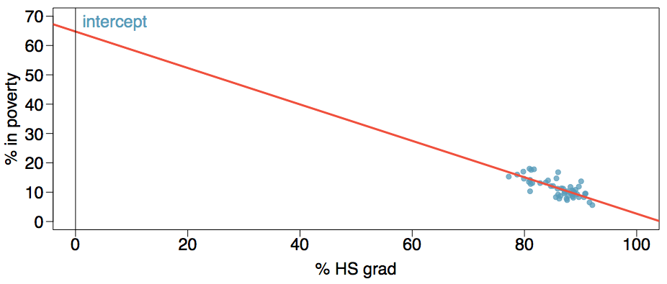
More on the intercept
Since there are no states in the dataset with no HS graduates, the intercept is of no interest, not very useful, and also not reliable since the predicted value of the intercept is so far from the bulk of the data.

Slide 40
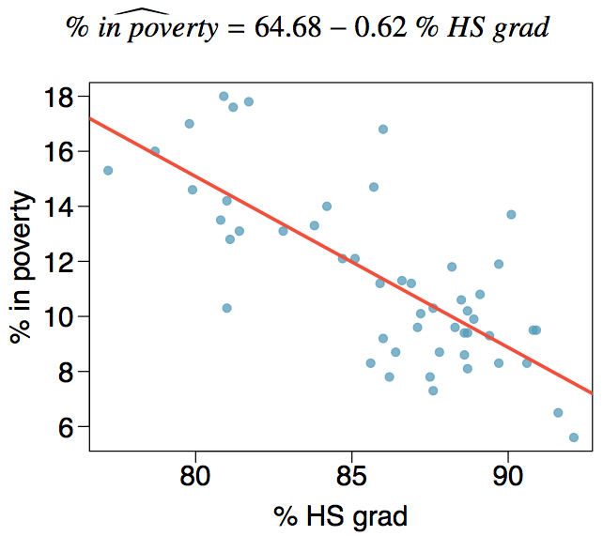
Regression line

Slide 41
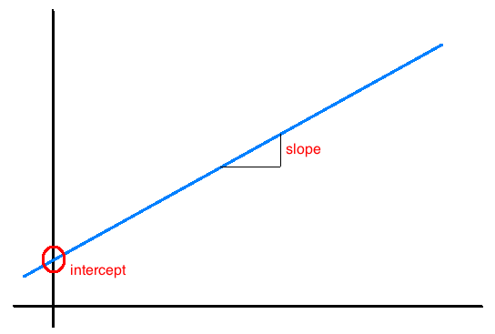
Interpretation of slope and intercept
Intercept: When x = 0, y is expected to equal the intercept.
Slope: For each unit in x, y is expected to increase / decrease on average by the slope.
Note: These statements are not causal, unless the study is a randomized controlled experiment.

Slide 42
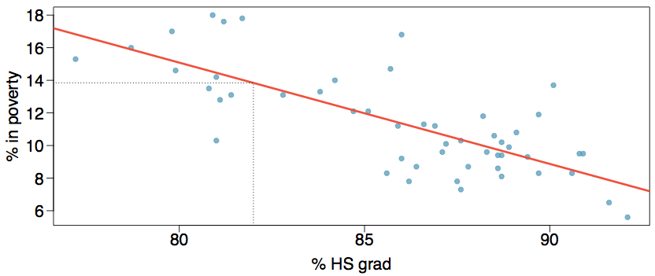
Prediction
Using the linear model to predict the value of the response variable for a given value of the explanatory variable is called prediction, simply by plugging in the value of x in the linear model equation.
There will be some uncertainty associated with the predicted value.

Slide 43
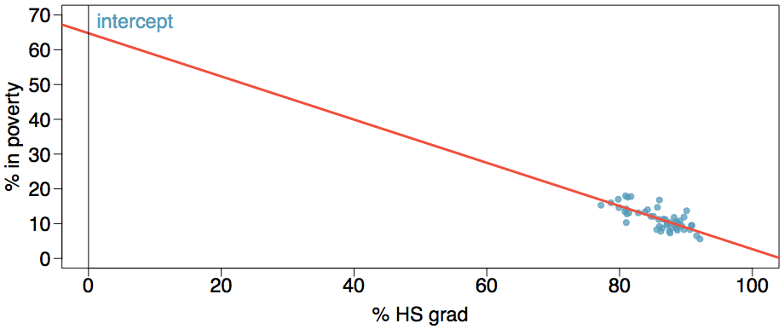
Extrapolation
Applying a model estimate to values outside of the realm of the original data is called extrapolation.
Sometimes the intercept might be an extrapolation.

Slide 44
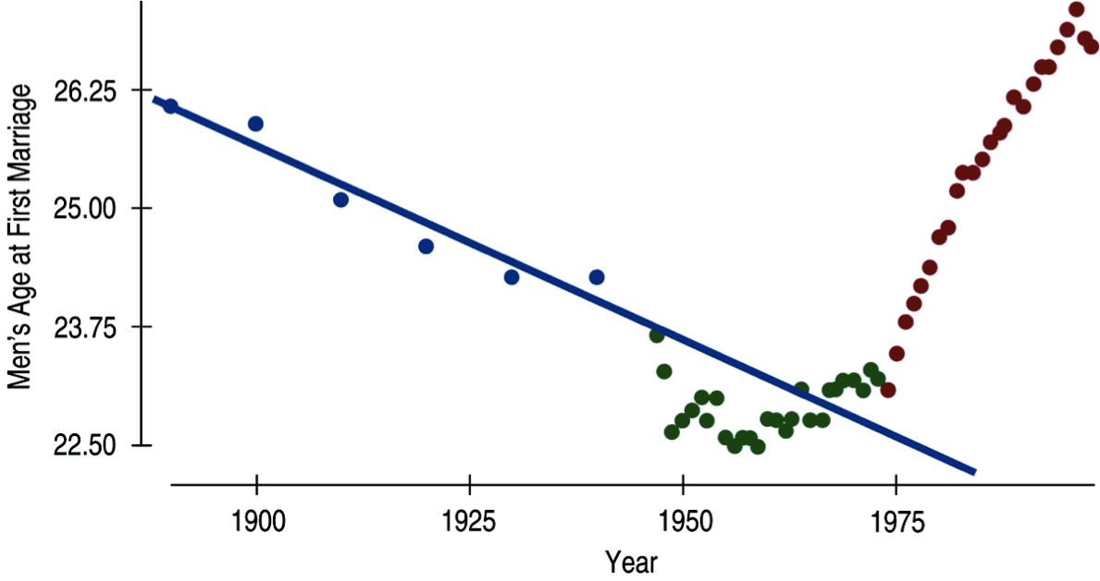
Examples of extrapolation

Slide 45
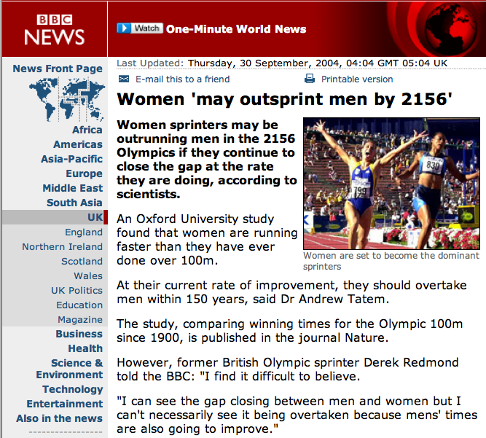
Examples of extrapolation

Slide 46
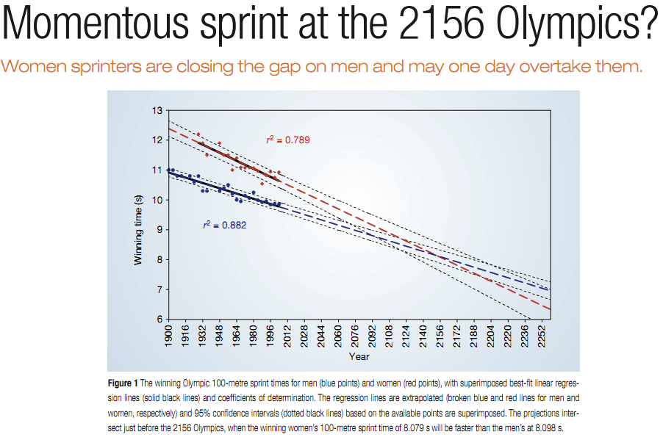
Examples of extrapolation

Slide 47
R²
The strength of the fit of a linear model is most commonly evaluated using R².

Slide 48
R²
The strength of the fit of a linear model is most commonly evaluated using R².
R² is calculated as the square of the correlation coefficient.

Slide 49
R²
The strength of the fit of a linear model is most commonly evaluated using R².
R² is calculated as the square of the correlation coefficient.
It tells us what percent of variability in the response variable is explained by the model.

Slide 50
R²
The strength of the fit of a linear model is most commonly evaluated using R².
R² is calculated as the square of the correlation coefficient.
It tells us what percent of variability in the response variable is explained by the model.
The remainder of the variability is explained by variables not included in the model or by inherent randomness in the data.

Slide 51
R²
The strength of the fit of a linear model is most commonly evaluated using R².
R² is calculated as the square of the correlation coefficient.
It tells us what percent of variability in the response variable is explained by the model.
The remainder of the variability is explained by variables not included in the model or by inherent randomness in the data.
For the model we've been working with, R² = -0.62² = 0.38.

Slide 52
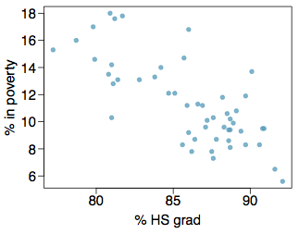
Interpretation of R²
Which of the below is the correct interpretation of R = -0.62, R² = 0.38?
38% of the variability in the % of HG graduates among the 51 states is explained by the model.
38% of the variability in the % of residents living in poverty among the 51 states is explained by the model.
38% of the time % HS graduates predict % living in poverty correctly.
62% of the variability in the % of residents living in poverty among the 51 states is explained by the model.

Slide 53
Interpretation of R²
Which of the below is the correct interpretation of R = -0.62, R² = 0.38?
38% of the variability in the % of HG graduates among the 51 states is explained by the model.
38% of the variability in the % of residents living in poverty among the 51 states is explained by the model.
38% of the time % HS graduates predict % living in poverty correctly.
62% of the variability in the % of residents living in poverty among the 51 states is explained by the model.

Slide 54
Find more resources at openintro.org/os, including
Slides
Videos
Statistical Software Labs
Discussion Forums (free support for students and teachers)
Learning Objectives
Teachers only content is also available for Verified Teachers, including
Exercise solutions
Sample exams
Ability to request a free desk copy for a course
Statistics Teachers email group
Questions? Contact us.

Slide 55
Extra Slides from the OS3 section on least squares regression

Slide 56

Poverty vs. region (east, west)
Explanatory variable: region, reference level: east
Intercept: The estimated average poverty percentage in eastern states is 11.17%

Slide 57
Poverty vs. region (east, west)
Explanatory variable: region, reference level: east
Intercept: The estimated average poverty percentage in eastern states is 11.17%
This is the value we get if we plug in 0 for the explanatory variable

Slide 58
Poverty vs. region (east, west)
Explanatory variable: region, reference level: east
Intercept: The estimated average poverty percentage in eastern states is 11.17%
This is the value we get if we plug in 0 for the explanatory variable
Slope: The estimated average poverty percentage in western states is 0.38% higher than eastern states.

Slide 59
Poverty vs. region (east, west)
Explanatory variable: region, reference level: east
Intercept: The estimated average poverty percentage in eastern states is 11.17%
This is the value we get if we plug in 0 for the explanatory variable
Slope: The estimated average poverty percentage in western states is 0.38% higher than eastern states.
Then, the estimated average poverty percentage in western states is 11.17 + 0.38 = 11.55%.

Slide 60
Poverty vs. region (east, west)
Explanatory variable: region, reference level: east
Intercept: The estimated average poverty percentage in eastern states is 11.17%
This is the value we get if we plug in 0 for the explanatory variable
Slope: The estimated average poverty percentage in western states is 0.38% higher than eastern states.
Then, the estimated average poverty percentage in western states is 11.17 + 0.38 = 11.55%.
This is the value we get if we plug in 1 for the explanatory variable

Slide 61
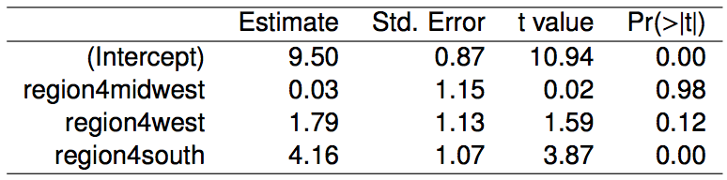
Poverty vs. region (northeast, midwest, west, south)
Which region (northeast, midwest, west, or south) is the reference level?
northeast
midwest
west
south
cannot tell

Slide 62
Poverty vs. region (northeast, midwest, west, south)
Which region (northeast, midwest, west, or south) is the reference level?
northeast
midwest
west
south
cannot tell

Slide 63
Poverty vs. region (northeast, midwest, west, south)
Which region (northeast, midwest, west, or south) has the lowest poverty percentage?
northeast
midwest
west
south
cannot tell

Slide 64
Poverty vs. region (northeast, midwest, west, south)
Which region (northeast, midwest, west, or south) has the lowest poverty percentage?
northeast
midwest
west
south
cannot tell

